Slide 1





CATTLE DISEASE PREDICTION USING
MACHINE LEARNING TECHNIQUES
AUTHORS
Parikshit Mahalle, Dean R&D VIIT Pune.
Suvarna Bhagwat, Professor VIIT Pune.
Anirudh Gote,SY Student
Dev Chhabada,SY Student
Pournima Bhosale,SY Student
Urvi Shah,TY Student
AFFIILIATION
Dept . Artificial Intelligence & Data Science
Vishwakarma Institute of
Information Technology , Pune

Slide 2
OUTLINE
Introduction
Objective
System Architecture
Methodology
Results
Comparative analysis
Conclusion

Slide 3

1. Introduction
Indian animal husbandry faces livestock health issues and limited veterinary knowledge.
Common cattle diseases globally challenge existing diagnostic techniques.
Proposal: Combine deep learning with classification algorithms for early cow disease identification using machine learning.
Goal: Reduce diagnostic errors, offer rapid disease detection for vets and farmers.
Initial assessments show potential benefits in animal care and disease control.
Future: Improve system, expand datasets, explore real-world deployment.

Slide 4

2. Objectives
Combine deep learning techniques (various CNN architectures) with a question-based diagnostic system.
Cover the entire disease detection process from data collection to outcome predictions
Conduct rigorous evaluations to validate the model's effectiveness.
Enhance model robustness and applicability across different cattle health contexts

Slide 5

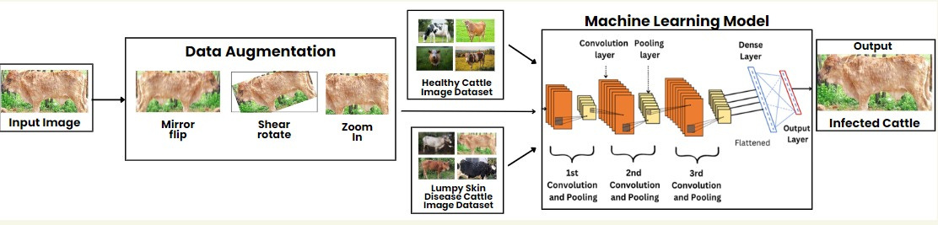
3. System Architecture

Slide 6
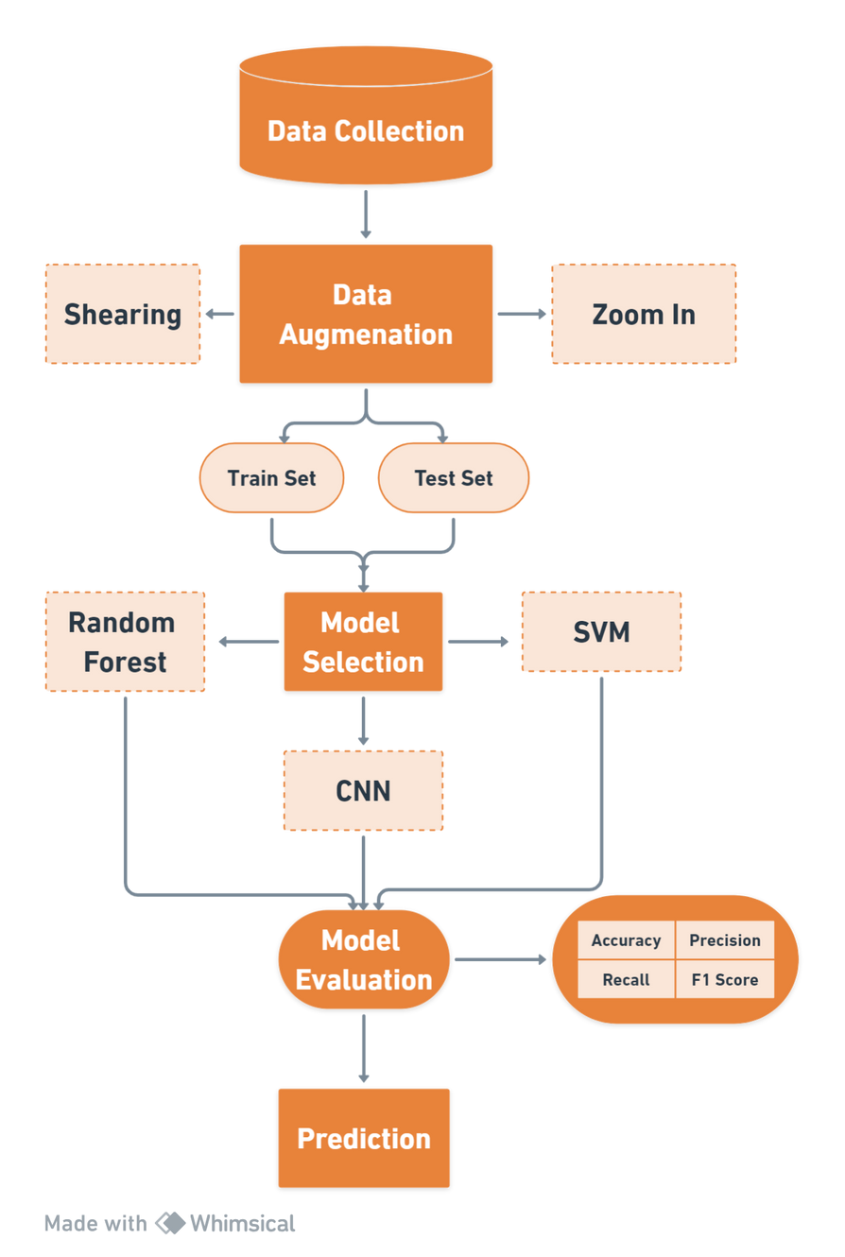

4. METHODOLOGY

Slide 7
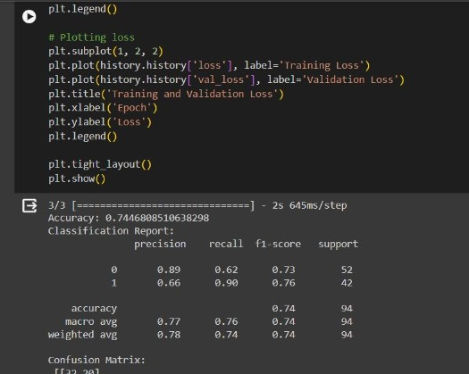
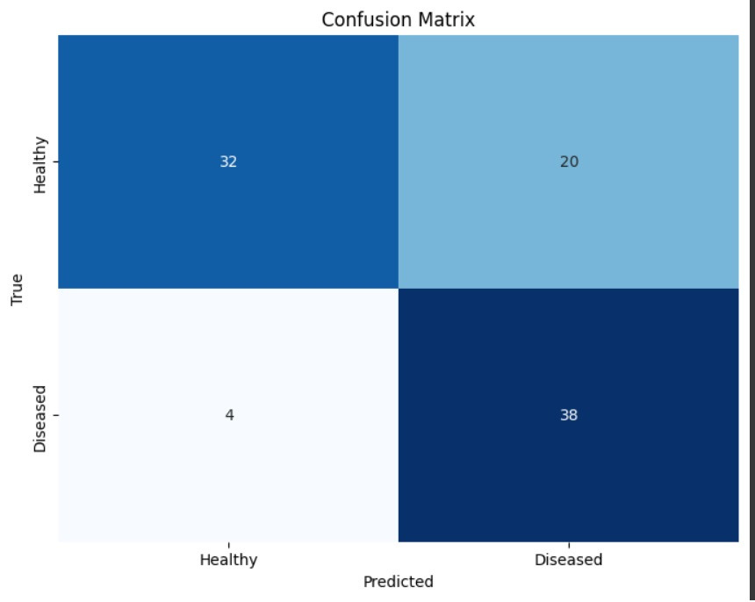
5.Results
1.Using CNN

Slide 8
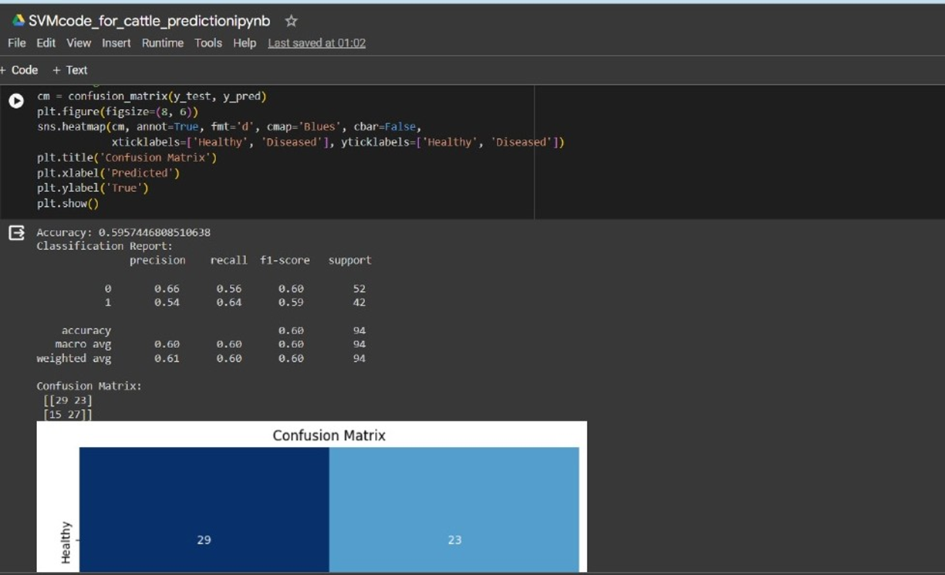
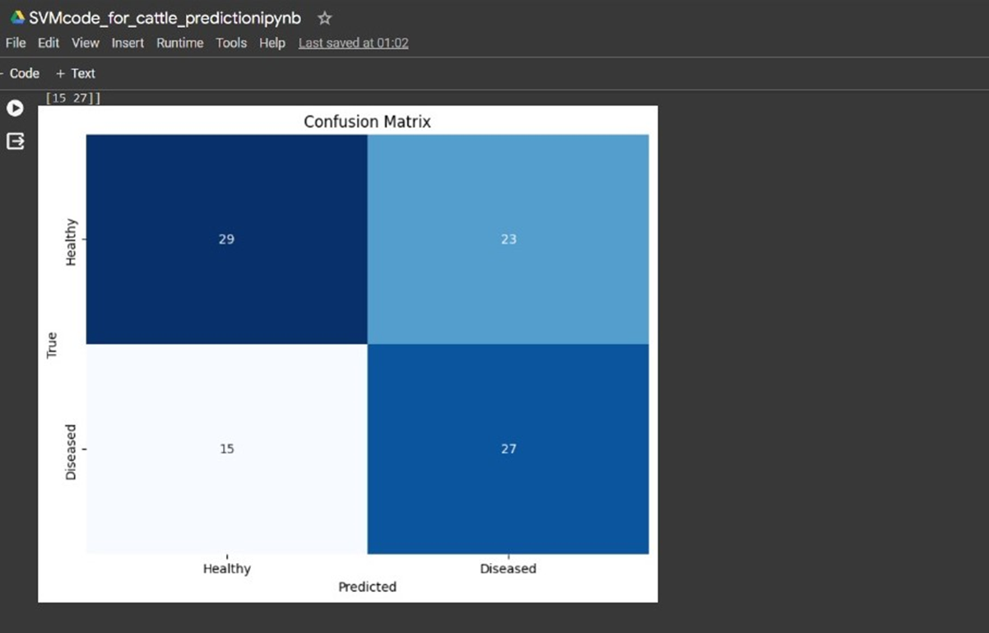
5.Results
2.Using SVM

Slide 9
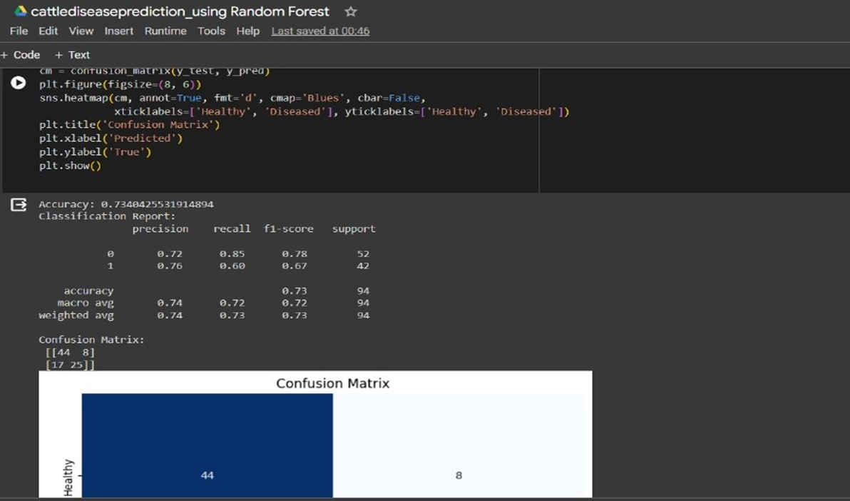
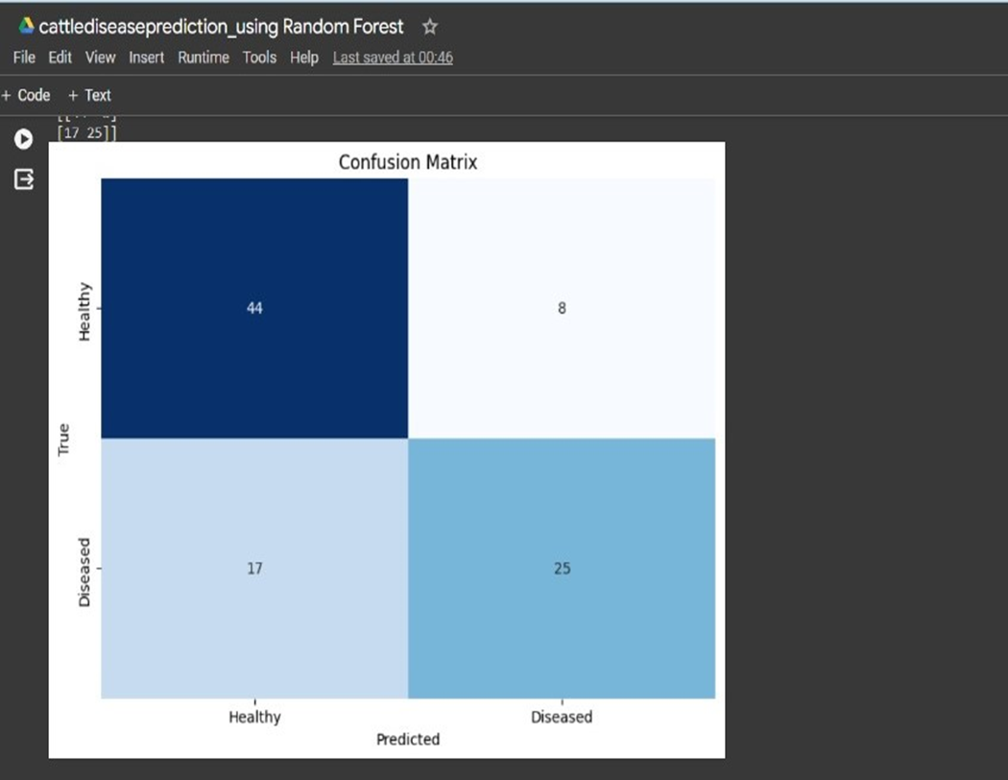
3.Using Random Forest

Slide 10
6.Comparative analysis
METHOD | ACCURACY | PRECISION | RECALL | F1 SCORE
CNN | 80.5 | 81 | 80 | 80
SVM | 59.6 | 61 | 60 | 60
RANDOM FOREST | 73.4 | 74 | 73 | 73

Slide 11
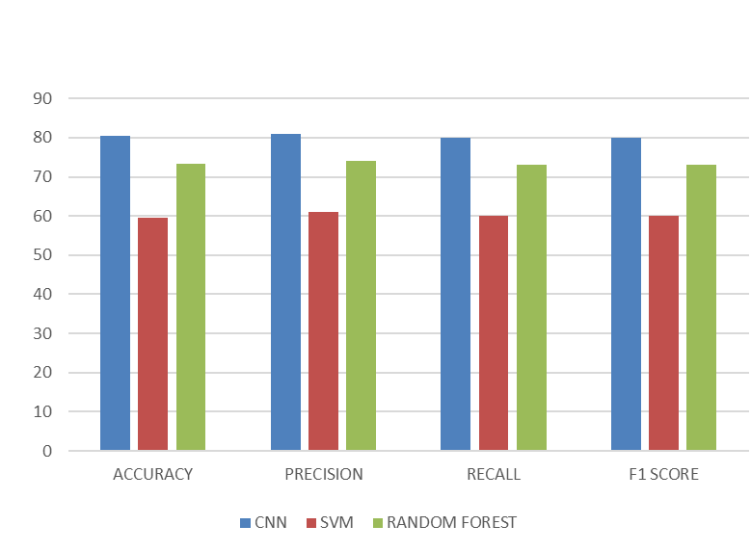
6.Comparative analysis

Slide 12
7.Conclusion
Enables early detection and remote access, transforming dairy industry practices.
Reduces errors, swiftly detects illnesses, enhancing cattle health.
It proves to be effective, offering accurate and timely predictions for cattle diseases.
Expanding the future scope to offer comprehensive disease analysis and suggest veterinary remedies.

Slide 13
THANK YOU

